Slide 1

Anomaly detection

Slide 2
Anomaly Detection
In data mining, anomaly detection is the identification of items, events or observations which do not conform to an expected pattern or other items in a dataset. Typically the anomalous items will translate to some kind of problem such as bank fraud, a structural defect, medical problems or errors in a text. Anomalies are also referred to as outliers, novelties, noise, deviations and exceptions.

Slide 3
Anomalies can be broadly categorized as:
Point anomalies: A single instance of data is anomalous if it's too far off from the rest. Business use case:Detecting credit card fraud based on "amount spent."
Contextual anomalies: The abnormality is context specific. This type of anomaly is common in time-series data. Business use case: Spending $100 on food every day during the holiday season is normal, but may be odd otherwise.
Collective anomalies: A set of data instances collectively helps in detecting anomalies. Business use case: Someone is trying to copy data form a remote machine to a local host unexpectedly, an anomaly that would be flagged as a potential cyber attack.

Slide 4
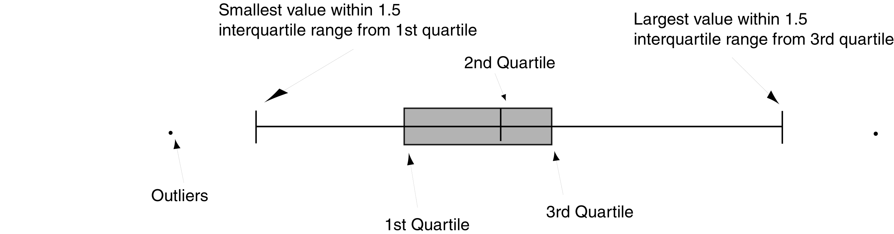
Boxplot

Slide 5
Anomaly Detection | Supervised Learning
Very small number of positive examples (y=1). (0-20 is common) | Large number of positive and negative examples
Many differet types of anomalies, Hard for any algorithms to learn what the negative examples look like, future anomalies may look nothing like any of past ones. | Enough positive examples for algorithm to get a sense of what positive examples are like, future examples may be similar to ones in training set.
E.g. – Fraud Detection Manufacturing Defects | Email spam classification

Slide 6
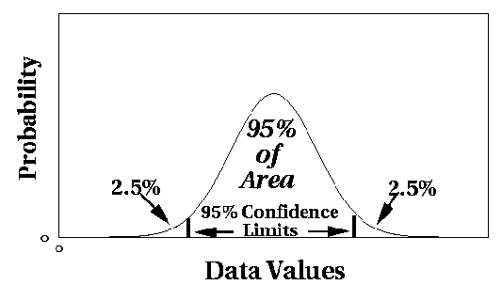
Statistical Approaches
Assume a parametric model describing the distribution of the data (e.g., normal distribution)
Apply a statistical test that depends on
Data distribution
Parameter of distribution (e.g., mean, variance)
Number of expected outliers (confidence limit)

Slide 7
Grubbs’ Test
Detect outliers in univariate data
Assume data comes from normal distribution
Detects one outlier at a time, remove the outlier, and repeat
H₀: There is no outlier in data
H_{A}: There is at least one outlier
Grubbs’ test statistic:
Reject H₀ if:

Slide 8
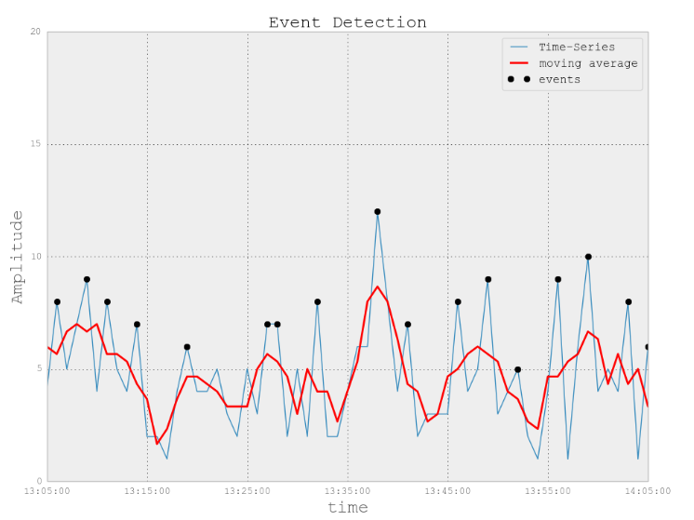
Moving Average
MOV = movingaverage(TimeSEries,5).tolist()
STD = np.std(MOV)
events= []
ind = []
for ii in range(len(TimeSEries)):
if TimeSEries[ii] > MOV[ii]+STD:
events.append(TimeSEries[ii])

Slide 9
Moving Average Implementation
cumsum_vec = numpy.cumsum(numpy.insert(data, 0, 0))
ma_vec = (cumsum_vec[window_width:] - cumsum_vec[:-window_width]) / window_wiadth

Slide 10
Limitations of Statistical Approaches
Most of the tests are for a single attribute
In many cases, data distribution may not be known
For high dimensional data, it may be difficult to estimate the true distribution

Slide 11
Other Techniques
One Class SVM
Robust Covariance
Isolation Forest
Local Outlier Factor

Slide 12
SVM (Support Vector Machine)

Slide 13
One-class SVM
Map data into feature space using kernel.
Find hyperplane S separating the positive data from the origin (negative) with maximum margin.
The probability that a positive test data lies outside of S is bounded by a prior v.
Relaxation parameters allow some outliers.

Slide 14
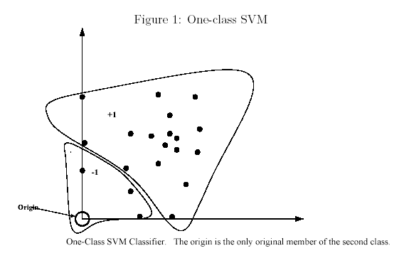
One-class SVM

Slide 15

ISOLATION FOREST
Anshu Pandey

Slide 16
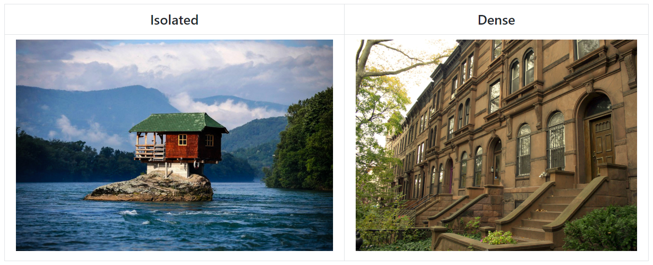
Intuition

Slide 17
Isolation Forest
Isolation Forest Outlier Detection uses a Random Forest of decision trees to detect data anomalies. The Isolation Forest ‘isolates’ observations by randomly selecting a feature, and then randomly selecting a split value between the maximum and the minimum values of the selected feature.

Slide 19
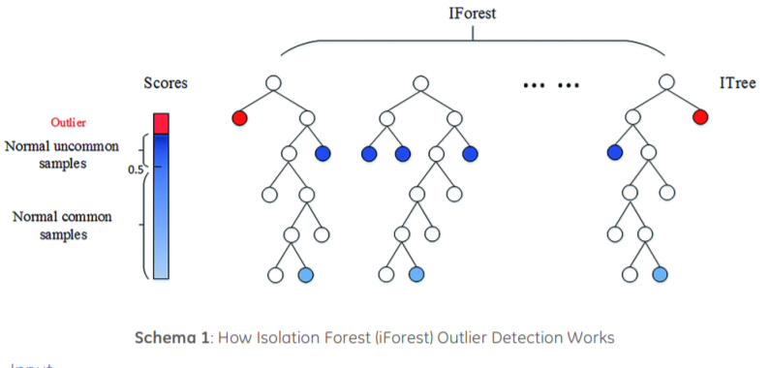
Working of Isolation Forest

Slide 20
Use Cases -
The Isolation Forest Outlier Detection use case is as follows:
• If “Target” labels are provided in the training data, the labels should be “1” and “-1”, where“1” stands for normal data and “-1” stands for anomalous data.
• Isolation Forest Outlier Detection is robust and can be applied to anomaly detection in high dimensions. However, time series anomaly detection is not recommended to be used here as time series data will be treated as non-time series data.

Slide 21
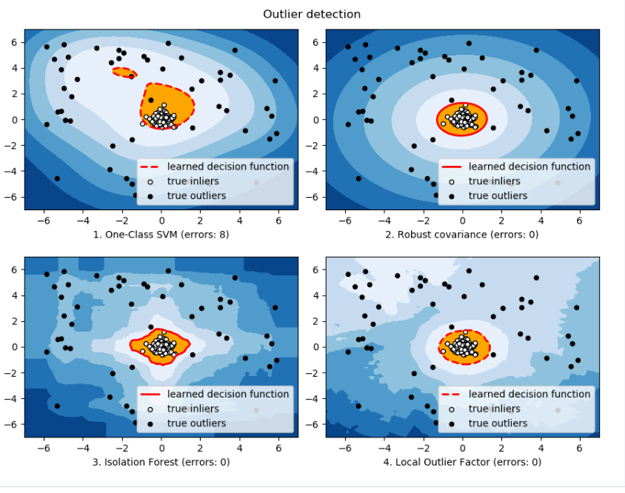

Slide 22
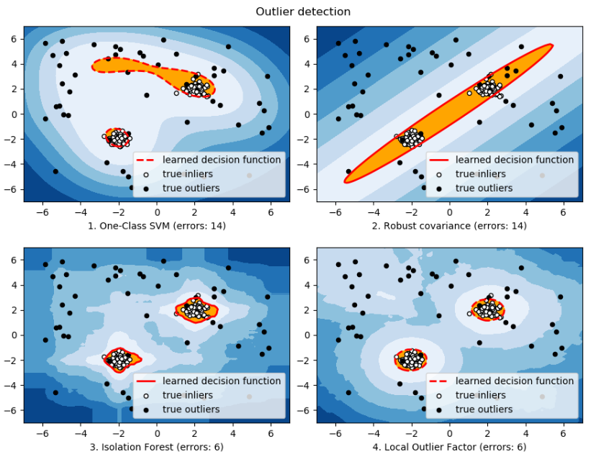

Slide 23
